Slide 1
Project Monitoring & Controlling
UNIT – 3

Slide 2
Contents
Framework for Management and control – Collection of data – Visualizing progress – Cost monitoring
Earned Value Analysis
Prioritizing Monitoring
Project tracking, Change control
Software Configuration Management
Contract Management.
MS Project

Slide 3
Creating Framework
Project Framework consists of
Understanding the Project Control Cycle
Establishing the Project structure

Slide 4
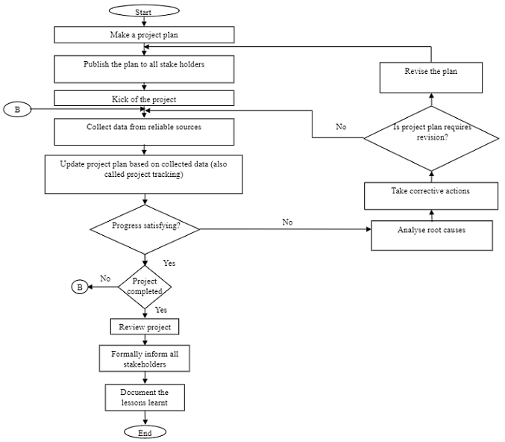
Project Control Cycle

Slide 5
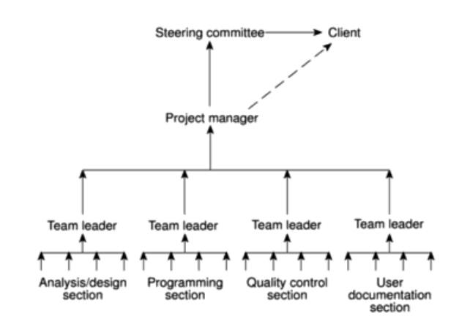
Assessing Project

Slide 6
Project Tracking
Collect Data
Cross check its validity
Update project plan
If it involves time & cost

Slide 7
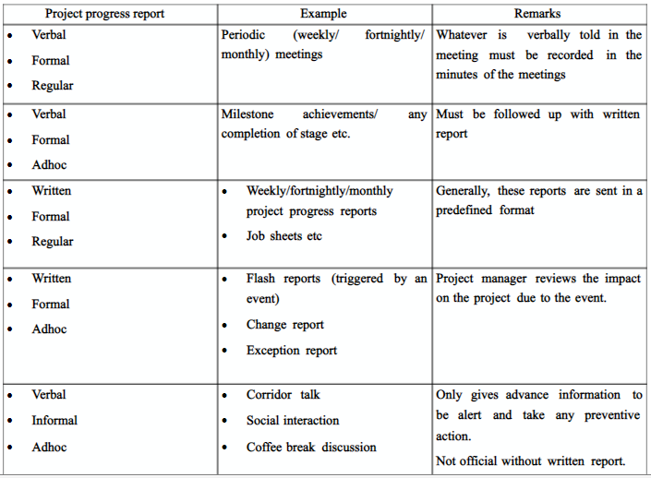
Collect Data – Reports

Slide 8
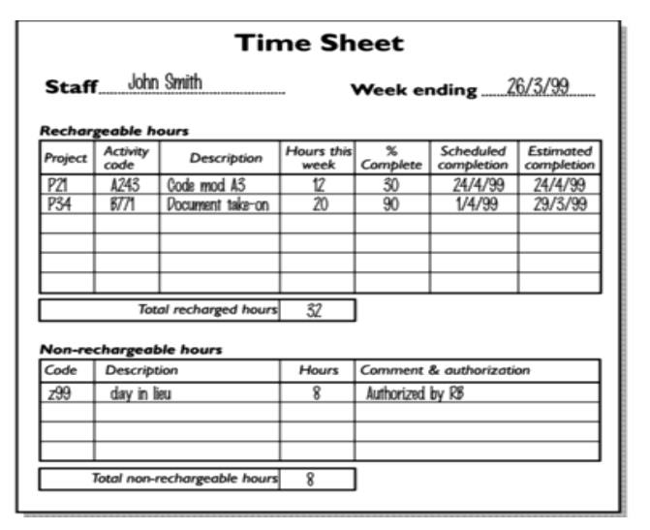
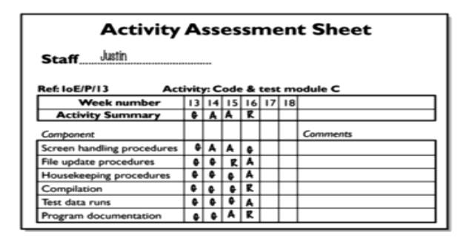
Collect Data – Reports

Slide 9
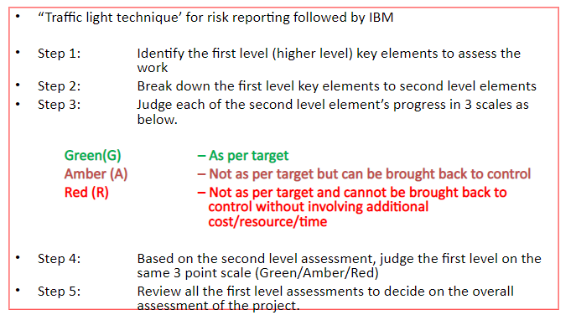
Collect Data – Risk Reports

Slide 10
Visualizing Progress
Gantt Chart
Slip Chart
Ball Chart
Timeline Graph

Slide 11
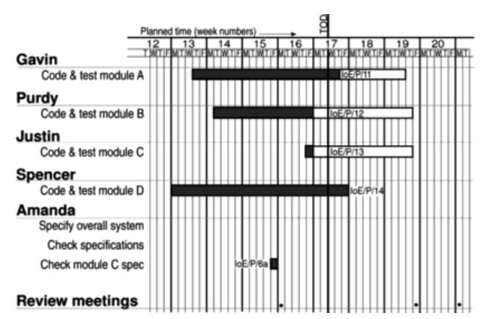
Gantt Chart

Slide 12
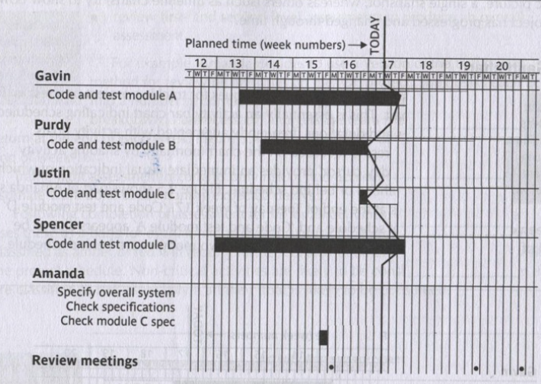
Slip Chart
Provides visual indication of activities which are not progressing in schedule

Slide 13
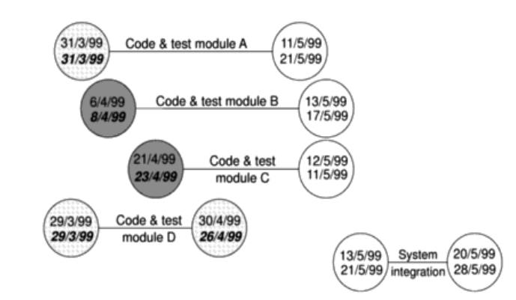
Ball Chart
Shows whether or not targets have been met

Slide 14
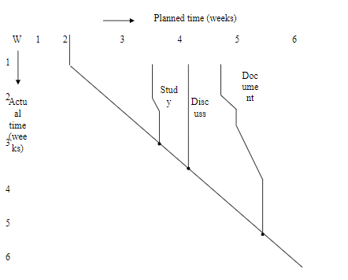
Timeline Graph

Slide 15
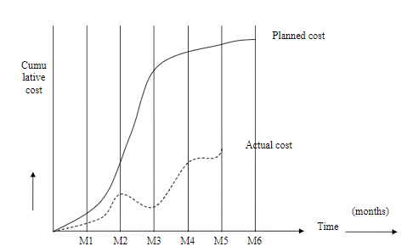
Cost Monitoring

Slide 16
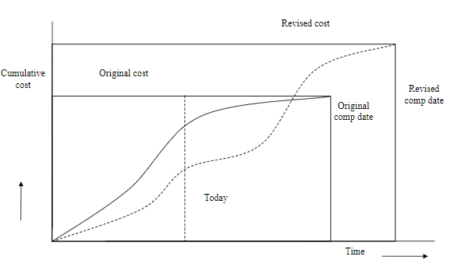
Cost Graph with cost /time extension

Slide 17
Earned Value Analysis (EVA
Earned Value Analysis (EVA) is an industry standard method of measuring a project's progress at any given point in time, forecasting its completion date and final cost, and analyzing variances in the schedule and budget as the project proceeds.
It compares the planned amount of work with what has actually been completed, to determine if the cost, schedule, and work accomplished are progressing in accordance with the plan.
As work is completed, it is considered "earned".
EVA answers 2 key questions
At the end of the project, is it likely that the cost will be less than, equal or greater than the original estimate?
Will the project likely to be completed on time?

Slide 18
Calculating Earned Value
Earned Value Management measures progress against a baseline. It involves calculating three key values for each activity in the WBS:
The Planned Value (PV), (formerly known as the budgeted cost of work scheduled or BCWS)—that portion of the approved cost estimate planned to be spent on the given activity during a given period.
The Actual Cost (AC), (formerly known as the actual cost of work performed or ACWP)—the total of the costs incurred in accomplishing work on the activity in a given period. This Actual Cost must correspond to whatever was budgeted for the Planned Value and the Earned Value (e.g. all labor, material, equipment, and indirect costs).
The Earned Value (EV), (formerly known as the budget cost of work performed or BCWP)—the value of the work actually completed.
These three values are combined to determine at that point in time whether or not work is being accomplished as planned.

Slide 19
Calculating Earned Value
The most commonly used measures are the cost variance:
Cost Variance (CV) = EV - AC
and the schedule variance:
Schedule Variance (SV) = EV - PV
These two values can be converted to efficiency indicators to reflect the cost and schedule performance of the project. The most commonly used cost-efficiency indicator is the cost performance index (CPI). It is calculated thus:
CPI = EV / AC
The sum of all individual EV budgets divided by the sum of all individual AC's is known as the cumulative CPI, and is generally used to forecast the cost to complete a project.

Slide 20
Calculating Earned Value
The schedule performance index (SPI), calculated thus:
SPI = EV / PV
is often used with the CPI to forecast overall project completion estimates.
A negative schedule variance (SV) calculated at a given point in time means the project is behind schedule, while a negative cost variance (CV) means the project is over budget.

Slide 21
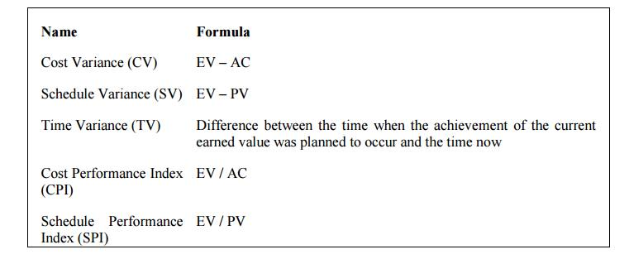
Earned Value Management Formula

Slide 22
Prioritizing monitoring
Critical path activities
Activities with no free float
Activities with less than a specified float
High risk activities
Activities using critical resources

Slide 23
Getting the project back to target
Strategies
Shortening the critical path
Altering the activity precedence requirements
Shorten critical path
Increased required resources
Make available resources, work overtime to meet the requirement
Ensure more efficient resources (specialists and experts)
Reconsider precedence requirements
Consider possibility of parallel activities
Consider training outside business hours

Slide 24
Change Control
Change control is a methodology used to manage any change requests that impacts the your project.
The change control process in project management ensures that each change proposed during a project is adequately defined, reviewed and approved before implementation.
The change control process helps avoid unnecessary changes that might disrupt services and also ensures the efficient use of resources.
That includes evaluating the request and then approving, rejected or deferring it.
Scientific techniques to control software changes is called Software Configuration Management (SCM)
Change control
Set of procedures to ensure that changes made only after a consideration of the full impacts.
Configuration management
Version control to ensure that all changes are properly recorded and managed – and so that knock-on effects on other projects can be identified.

Slide 25
Need for Change
Changes in business strategy
New customer needs due to market driving forces
Reorganization of the business
Budgeting or scheduling constraints
New regulations imposed by the Government
Changes in Technology

Slide 26
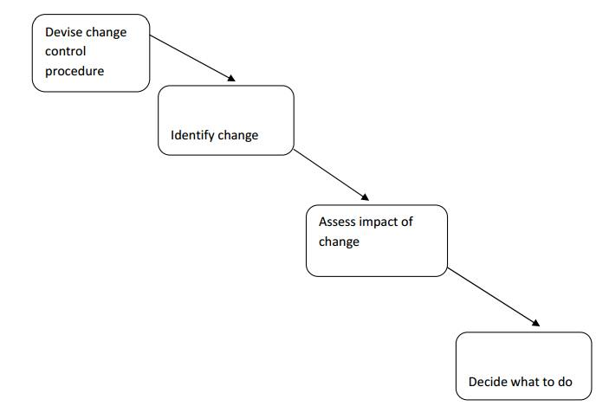
Change Control
Change control contains five stages:
Proposing a Change
Summary of Impact
Decision
Implementing a Change
Closing a Change
There are two documents used during the process:
Change Log: used to provide a record of all changes requested and decisions made
Change Request Form: used to document details of the change, including the business case

Slide 27
Change Control
Proposing a Change
This process gives the ability for anyone in the project team (including the customer) to suggest a change to the project. The proposal must include a description of the change and expected benefits or other reason for the change. The change is presented using the Change Request Form and added to the Change Log for the project.
Summary of Impact
This process is carried out by the project manager, who will consider the overall effect on the project, covering the following items:
Quantifiable cost savings and benefits
Legal, regulatory or other unquantifiable reason for change
Estimated cost of the change
Impact on timescales
Extra resources needed
Impact on other projects and business activities
New risks and issues
After this assessment, the project manager recommends whether to carry out the change.

Slide 28
Change Control
Decision
This process involves a review of the change request by an approved authority who will consider all the information provided by the project manager and person making the request. The decision will usually be:
Accept
Accept with comments and special conditions
Reject
Defer (change is not approved, but is left for consideration later)
Implementing a Change
If the change is approved it is planned, scheduled and executed at a time agreed with the stakeholders.
As part of the planning, a regression test plan is needed in case the change needs to be backed out.
After implementation, it is usual to carry out a post-implementation review.
Closing a Change
Once implemented, the requester checks and agrees on the change, and it is closed in the Change Log by the project manager.

Slide 29
Managing contracts
Contract administration is the management of contracts made with customers, vendors, partners, or employees.
The personnel involved in Contract Administration required to negotiate, support and manage effective contracts that are expensive to train and retain.
Contract management includes negotiating the terms and conditions in contracts and ensuring compliance with the terms and conditions, as well as documenting and agreeing on any changes or amendments that may arise during its implementation or execution.
It can be summarized as the process of systematically and efficiently managing contract creation, execution, and analysis for the purpose of maximizing financial and operational performance and minimizing risk.

Slide 30
Types of contract
Fixed Price
Time & material
Fixed price per delivered unit

Slide 31
Fixed Price Contracts
Supplier must execute all the commitments as described in the contract for a specific amount of money as decided in the contract.
The price is fixed and cannot be altered unless the contract is renegotiated.
Advantage:
Customer understanding
Known income/expenditure
Supplier efficiency
Disadvantages
Difficulties in changes to environment
Risk absorption
Threat to quality

Slide 32
Time and Material Contract
Supplier will charge at a fixed rate per unit of effort
E.g. different rates for man programmer hours, man-analyst hours etc. all already fixed
Supplier and the acquirer will guess estimate the efforts and the time required at various levels to complete the project. These are only estimates to plan resources and activities and not the basis for final payment.
Advantages
Ease of changing requirements
Lack of price pressure
Disadvantages
No supplier role for cost effectiveness
Customer liability

Slide 33
Fixed price per delivered unit
Prices are fixed for design, coding, implementation and support based on function points.
Advantages
Customer clarity
Competitive nature
Changing requirements
Supplier efficiency
Flexibility
Disadvantages
Difficulty in measurements
Changing requirements

Slide 34
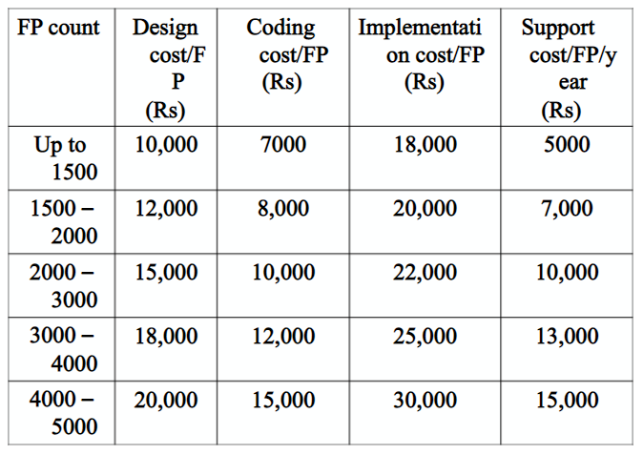
Fixed price per delivered unit

Slide 35
Contract Management
Responsibility
Supplier
Work execution
Acquirer
Managing and ensuring that the project is on right track
Approvals
Every milestone
Change Control
Use of SCM
Sync of both parties
Periodic meetings and signed minutes
Periodic reports and acknowledgements

Slide 36
MS Project
Microsoft Project (MSP) is a project management software made for project managers so they can control their projects.
Depending on your plan, Microsoft Project lets you plan projects, assign tasks, manage resources, make reports and more.

Slide 37
Thank You!

